Slide 1
Java Web Start The New Way to Open Oracle Financials Form Applications
11 April, 2018

Slide 2
What is Java Web Start
Java Web Start changes the way that Java Applet Forms runs on end-users desktops in order to open Oracle Financials form driven applications such as the General Ledger, Accounts Payable, Accounts Receivable, CAPS, CSMA, & Oracle Assets to name a few modules.
Java Web Start architecture is primarily driven by modern web browsers ending support for the Netscape Plug-in Application Programming Interface (NPAPI), which is used by the Java Plug-in. Currently, Oracle Financials form applications rely on these soon to be deprecated Java Plug-in interfaces needed to open Oracle Forms.
Java Web Start applications can be launched independently of a browser since they do not rely on a browser plug-in; it provides a migration path from Java applets.

Slide 3
Java Web Start Will Resolve the Problem Below
Oracle Financials E-Business Suite interacts with browsers through HTML web pages and Oracle Application Framework Forms pages, depending upon what the end user is trying to accomplish. Currently, forms are opened from the EBS Home page by a Java applet which is launched by the Java Plug-in using a browser that supports plug-ins via the NPAPI protocol (Netscape Plugin Application Programming Interface). Java Plug-in is being phased out.
IE11 and Firefox ESR 52.x (& lower) are the only browsers left which support the existing JRE Plug-in.
Some examples of the E-Business Suite HTML pages are the Home Page, HCOM iProcurement, PCARD, & Vendor Request. These pages will continue to work in modern browsers and are not impacted by this Java Plug-in deprecation and Java Web Start change.
Firefox ESR 52.x will continue to allow the use of the NPAPI plug-in for Java through May 2018. Future releases of Firefox will not support NPAPI plug-in.

Slide 4
What is Changing with Java Web Start
All common browsers will now work with the Oracle Financials applications. More choices for the users to use a preferred browser.
Successfully Tested functionality on the following Browsers
Internet Explorer 11 for Windows
Microsoft Edge for Windows
Google Chrome for Windows
Firefox ESR 52 & beyond for Windows
Safari for Windows
Please Note: Safari on the Mac will continue to work with the Java Plug-in (Oracle is still working on a solution for the Mac)
In most of the browsers Oracle Forms will open either seamlessly or with a one time single click or one extra click. Browser specific behavior is available in following slides.
Drill down from Java Forms to HTML pages will appear somewhat different.
Only one form session of Oracle Financials per Environment can be open at a time.

Slide 5
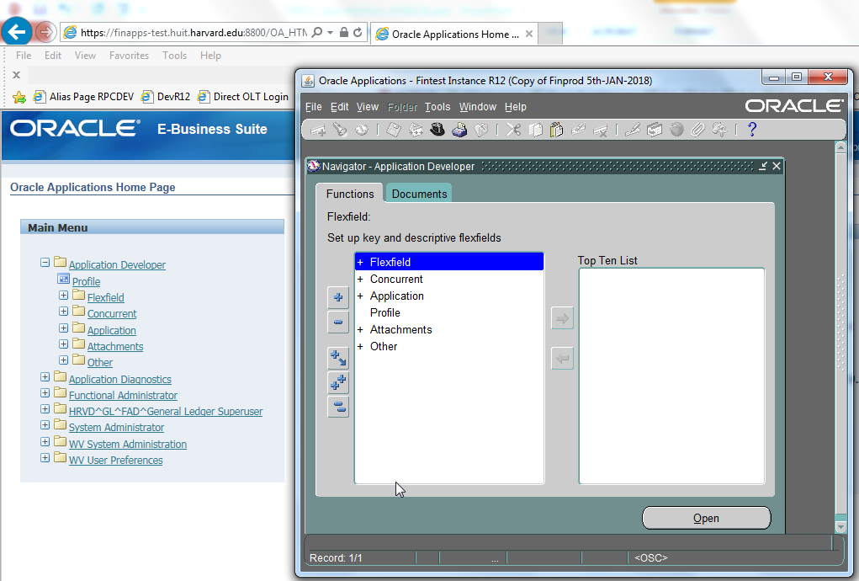
What is Changing
HTML & Forms Independence
With Java Web Start, Oracle gives you the flexibility to close the HTML Page and continue working in Oracle Forms whereas in today’s world Oracle Forms are closed as soon as you close the HTML Browser page.

Slide 6
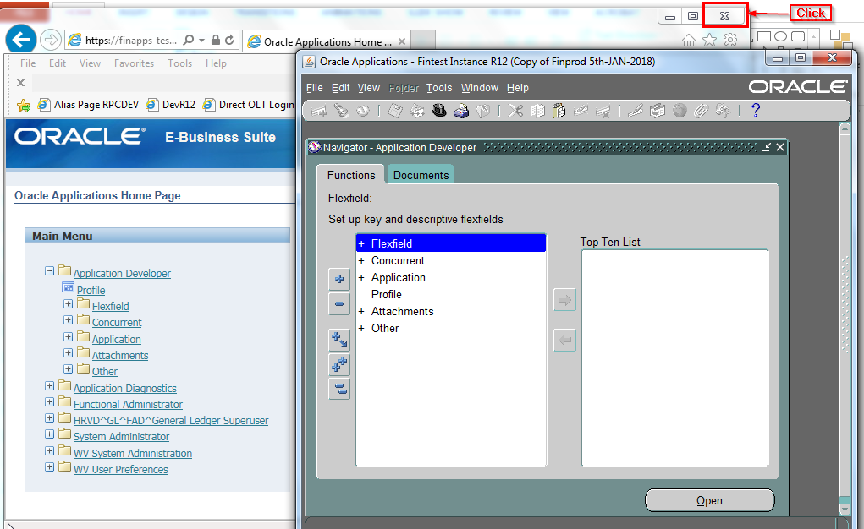
What is Changing
HTML & Forms Independence – contd.
Close the Oracle Home Page Browser.

Slide 7
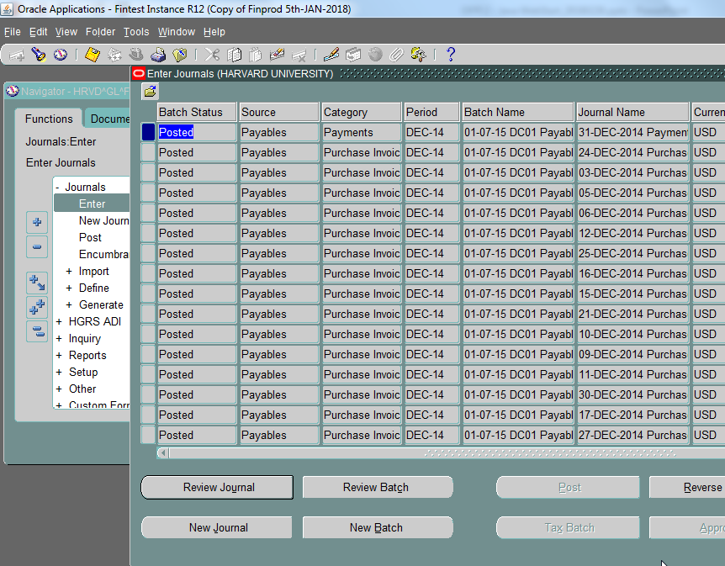
What is Changing
HTML & Forms Independence – contd.
You can still do tasks in Oracle Forms like Data Entry, Viewing Output/Log of Concurrent Requests etc.

Slide 8
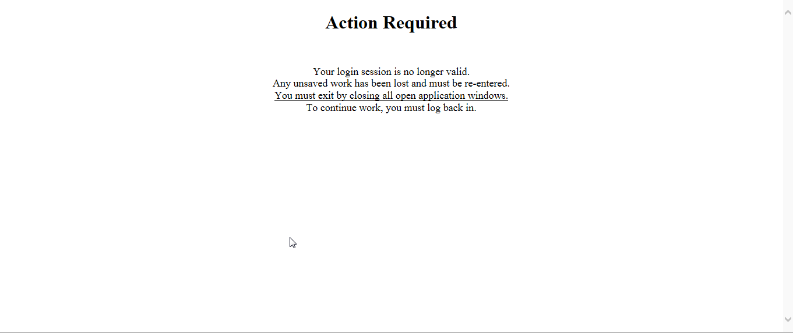
What is Changing
HTML & Forms Independence – contd.
However you cannot navigate back to an Oracle HTML responsibility like iProcurement - an error message will be received as shown below.

Slide 9
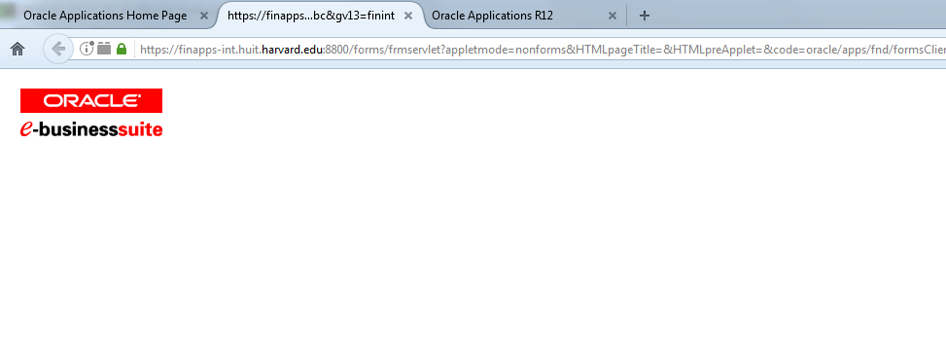
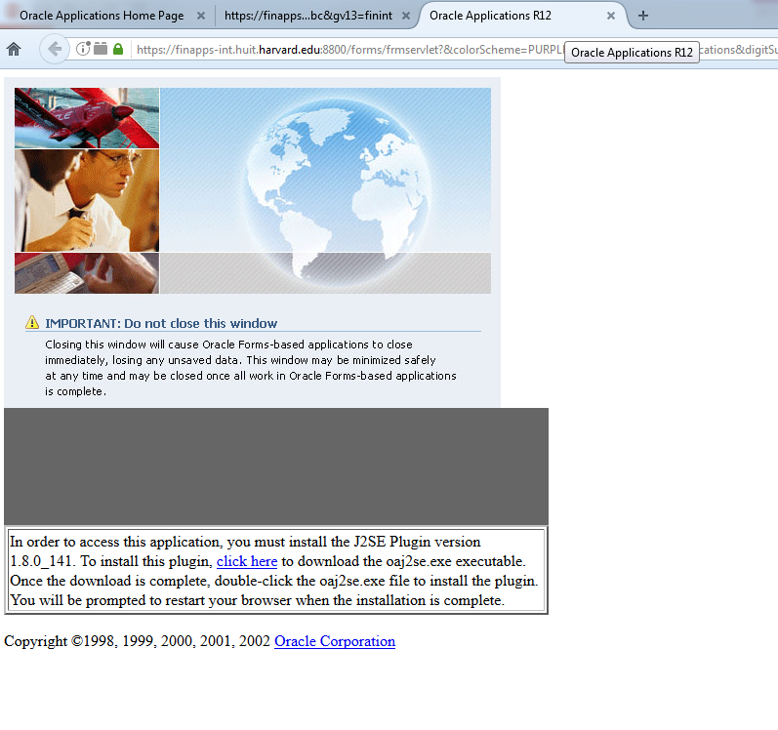
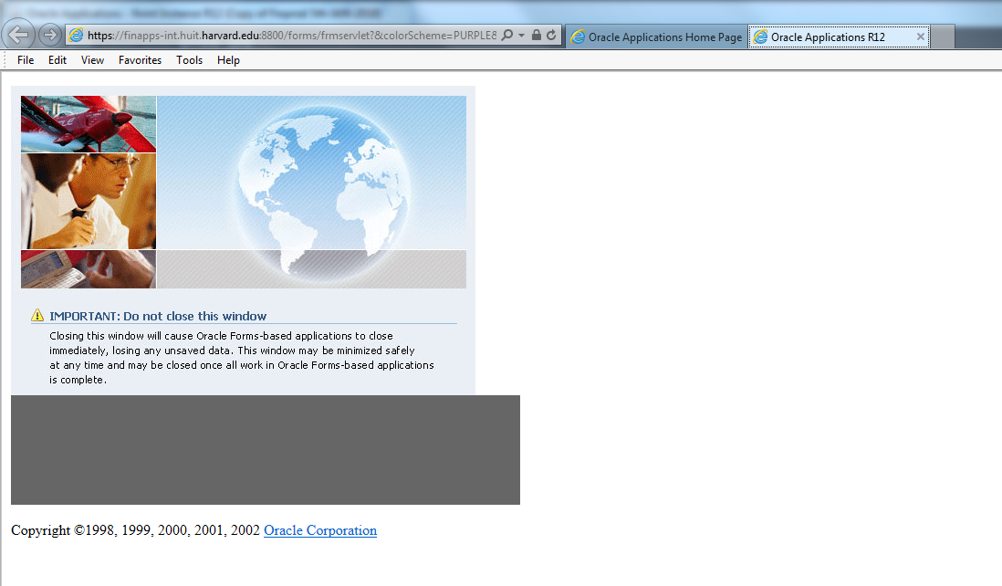
What is Changing
Elimination of Extra Browser Tabs
After Java Web Start users will not see the extra Java browser tabs which are shown in the screenshots below.
Firefox Example
=============
Internet Explorer Example
=====================

Slide 10
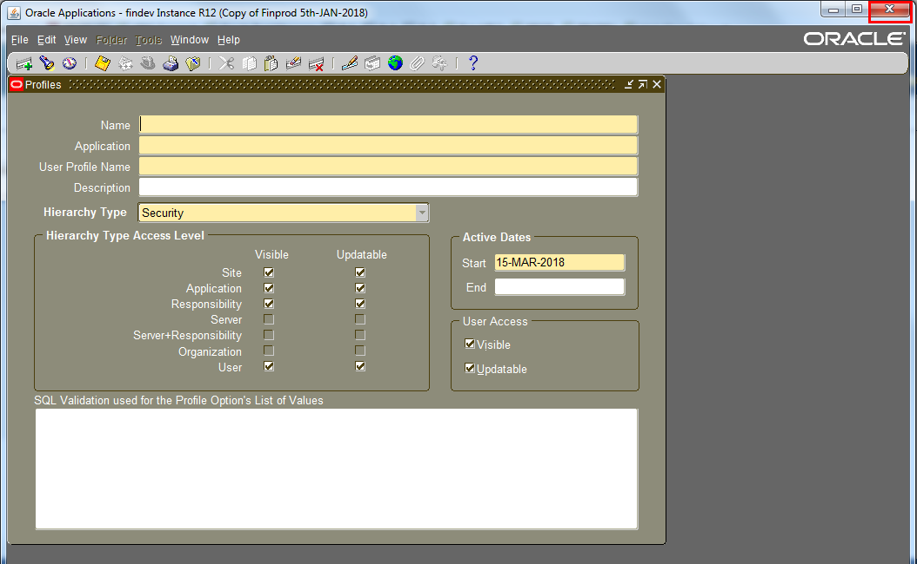
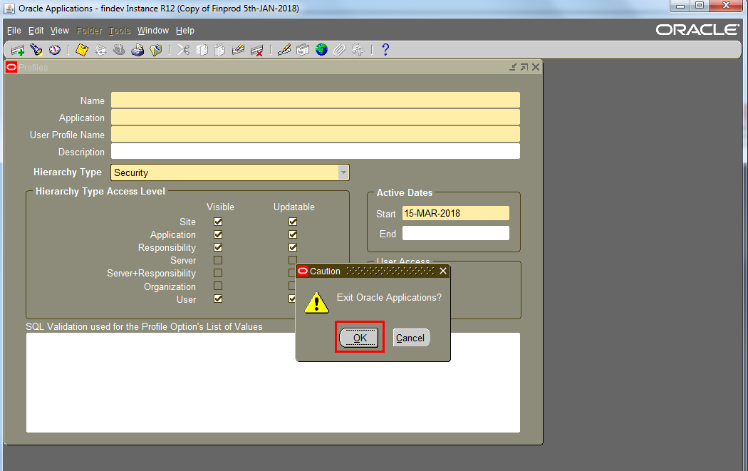
What is Changing
Impact on Logout/Exit from Oracle
Currently, if a user only closes the HTML homepage, that automatically closes the Java Forms session as well but that’s not going to happen after Java Web Start.
This new independence has an impact and users will need to change the way they logout/exit from Oracle.
Now to exit completely from Oracle properly, users should first close the Java Forms Window and then click Logout on the HTML Browser page.

Slide 11
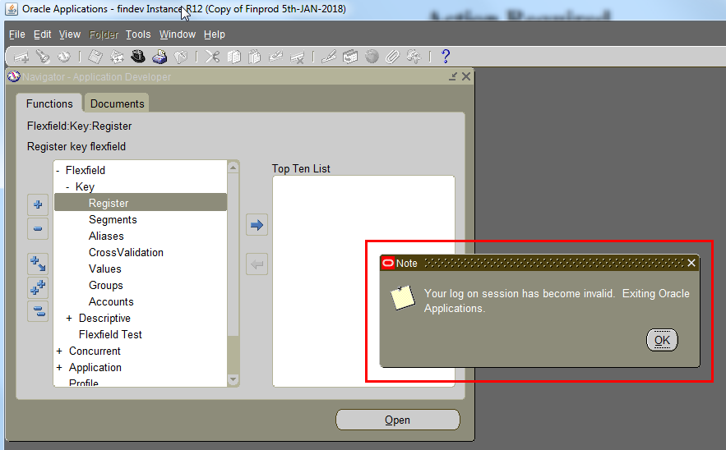
What is Changing
Impact on Logout/Exit from Oracle – contd.
If a user clicks Logout on the HTML Browser page before closing the Java Forms, the Java Forms will remain open and an error will be received when you try to do anything on them.

Slide 12
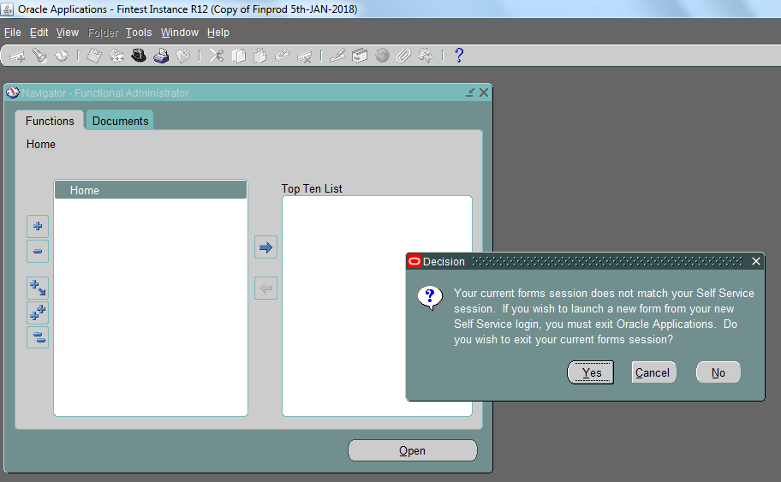
What is Changing
Concurrent Oracle Form Sessions per Environment
Java Web Start has a limitation that it only allows 1 form session per Environment. A warning/confirmation message will be received if you try to open the 2nd form session as shown below.

Slide 13
What is Changing
Concurrent Oracle Form Sessions per Environment – contd.
If you click Yes, the current form session will close and you will have to click on the Function Link again to open the new Oracle Form session.
If you click Cancel or No, the current form session will continue and the second session will not become active.

Slide 14
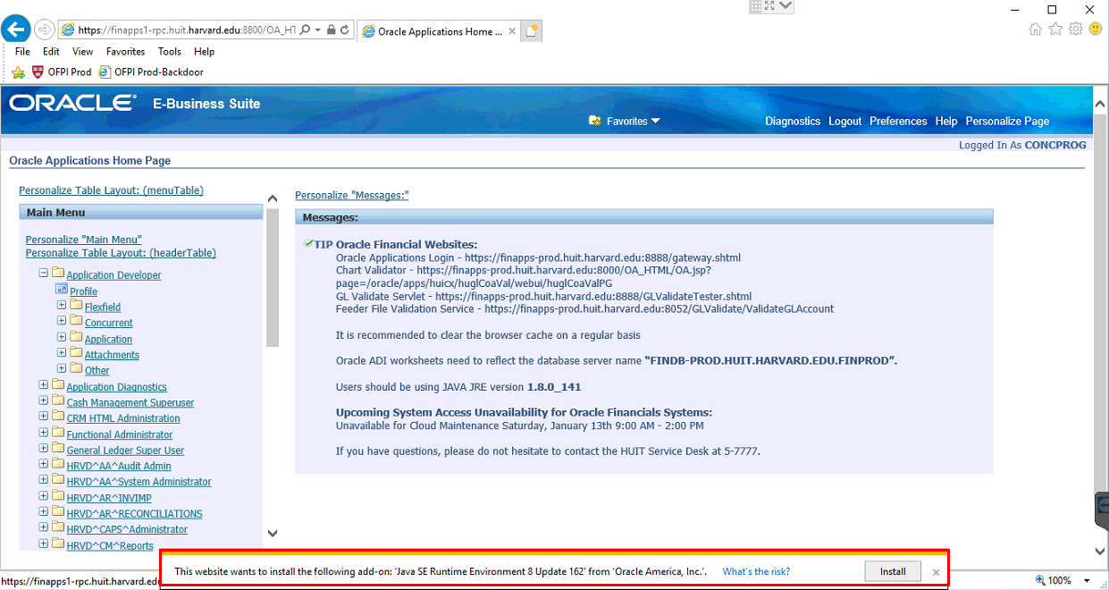
What is Changing
No More Local JRE Update Message for Windows PC Users
After Java Web Start, Windows PC users can continue working with a lower version of Local JRE (baseline of 1.8.0_141) even when the Oracle Server has a higher version of JRE (1.8.0_162 or higher) which means they will no longer see a message to update the JRE when accessing Oracle. Mac Users will continue to see this and will need to act accordingly.

Slide 15
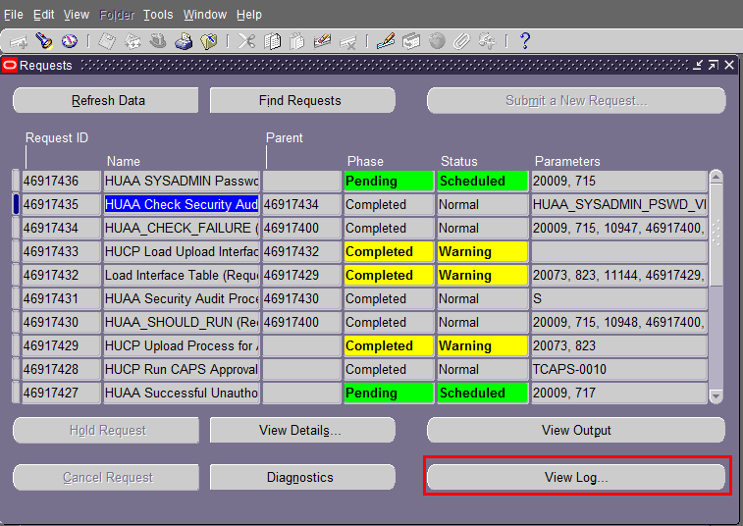
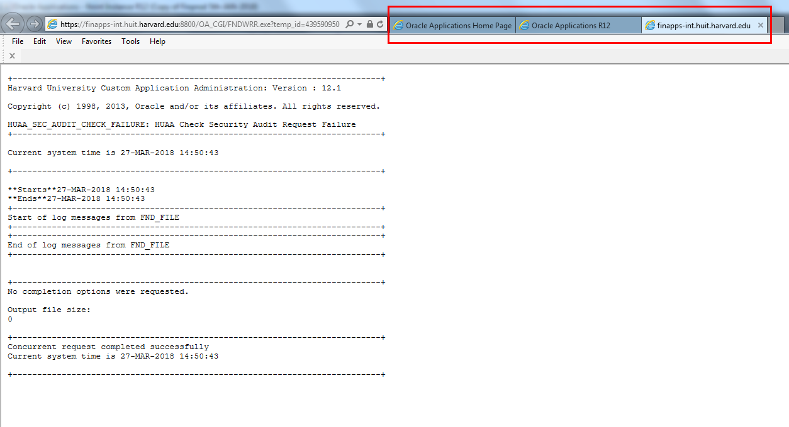
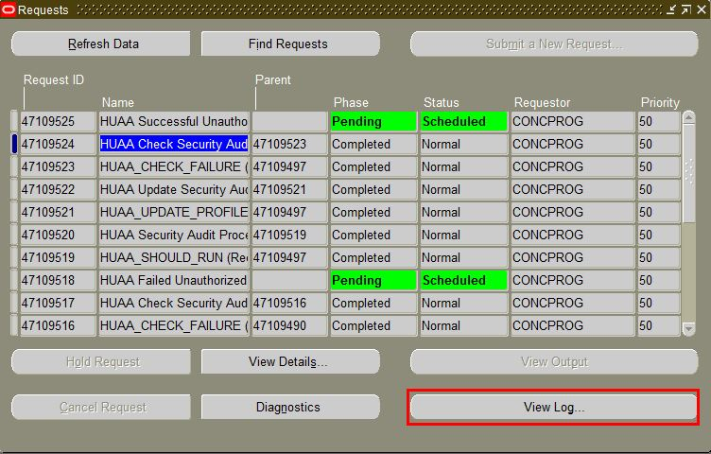
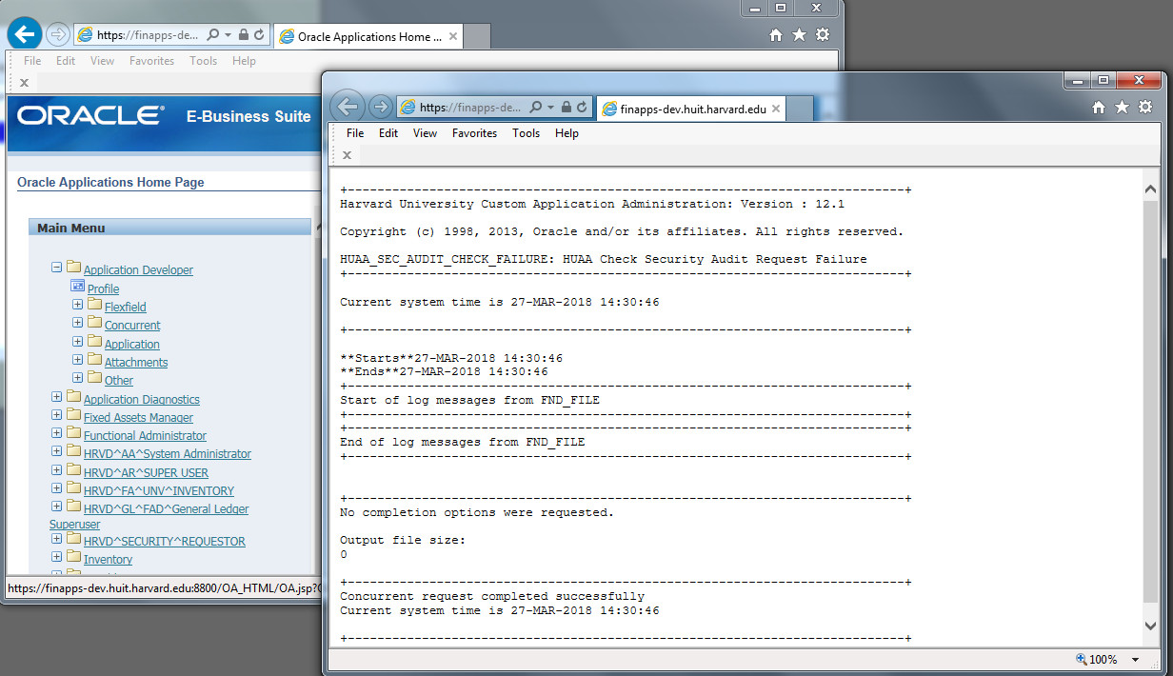
What is Changing
Windows vs Tabs (Only for Internet Explorer)
With Java Web Start, the core of how Java events are handled has been changed and as a result, all the events which lead to opening up of a browser will now invoke a new browser window instead of opening a new tab in the existing browser session.
E.g. after Java Web Start if you try to open a concurrent request output/log or try to navigate to a HTML only responsibility from Java Forms, it will open a new browser window instead of opening a new tab in the existing browser session.
Before
After

Slide 16
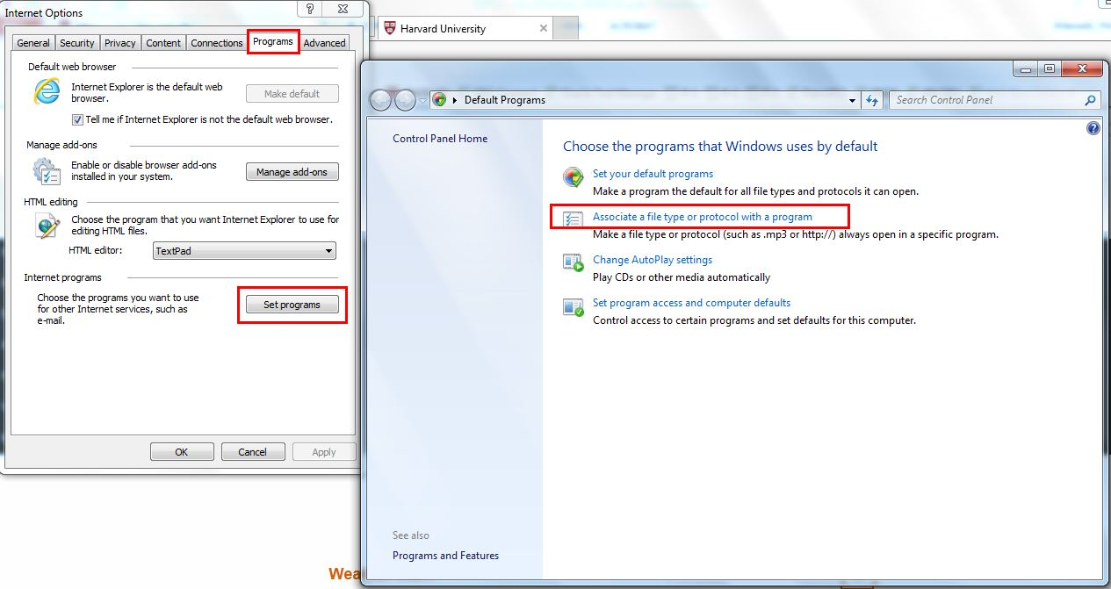
Browser Behavior – IE11 with Windows
Seamless Auto Opening of Forms – JNLP Files are automatically linked to Java Web Start when JRE 8 update 141 or latest is installed. Desktops will already have the necessary file associations to make this work. These are found:

Slide 17
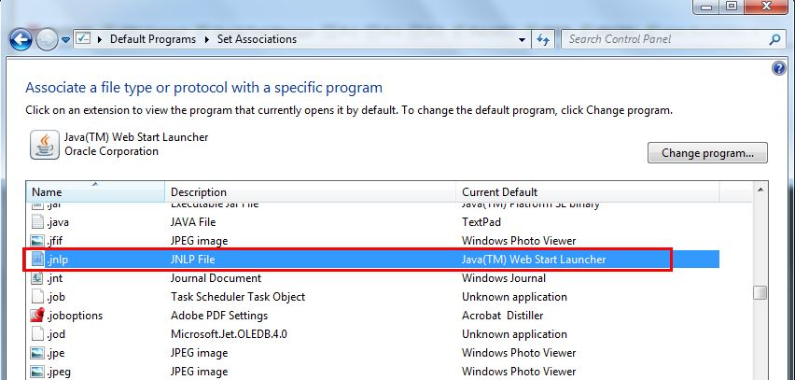
Browser Behavior – IE11 – contd.
No additional Browser setting is required.
No Extra Clicks to open Oracle Forms.

Slide 18
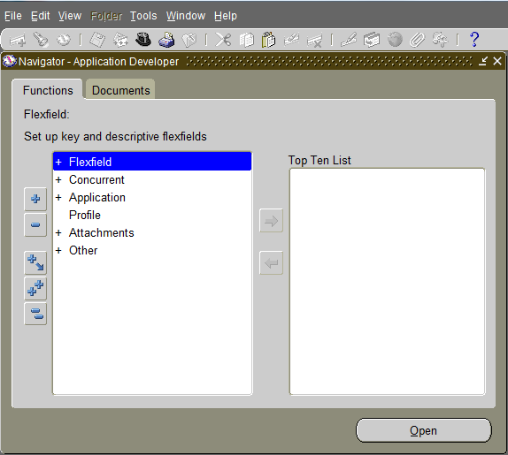
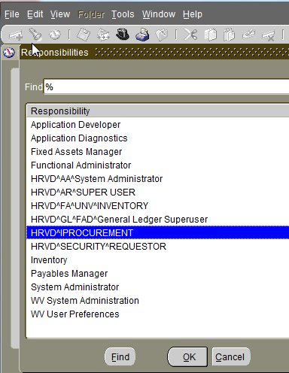
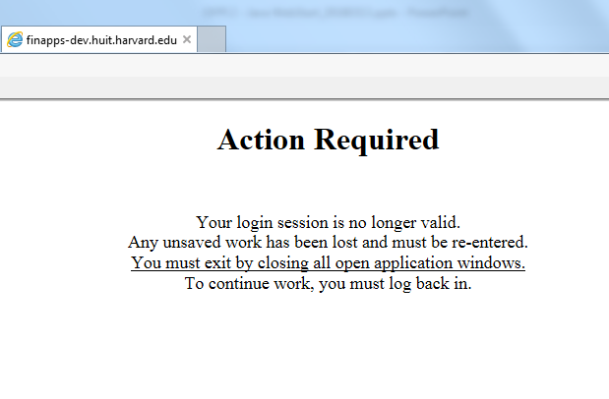
Browser Behavior – IE11 – contd.
Navigation from Java Form to HTML and vice versa.
There is an known issue with Internet Explorer which prevents users from going to an HTML responsibility like iProcurement from Java Forms.
Users will receive the error message as shown in the screenshot below.
However, we have resolved this issue!

Slide 19
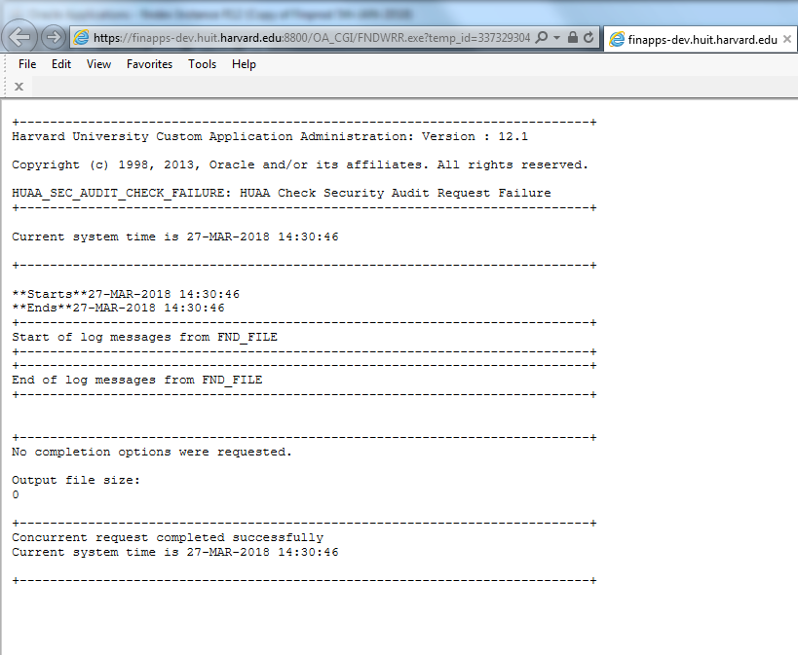
Browser Behavior – IE11 – contd.
Navigation from Java Form to HTML and vice versa.
This issue does not impact opening of Output or Log files of concurrent requests.

Slide 20
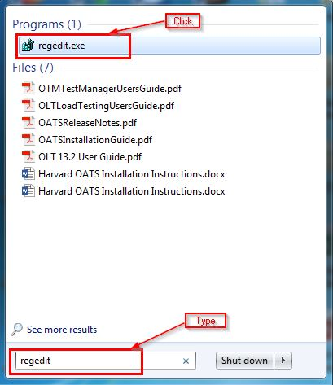
Browser Behavior – IE11 – contd.
Registry setting for fixing the navigation from Java Form to HTML and vice versa.
Computer\HKEY_CURRENT_USER\Software\Microsoft\Internet Explorer\Main – set frame merging from 0 to 1
The HUIT Endpoint team will push this setting to users and their local portal manager to avoid Users from encountering this issue.
The setting depiction is seen below.

Slide 21
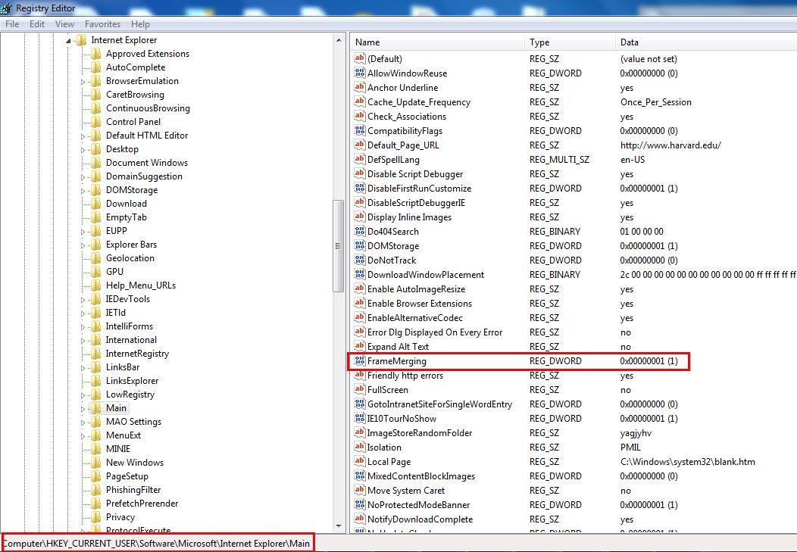
Browser Behavior – IE11 – contd.

Slide 22
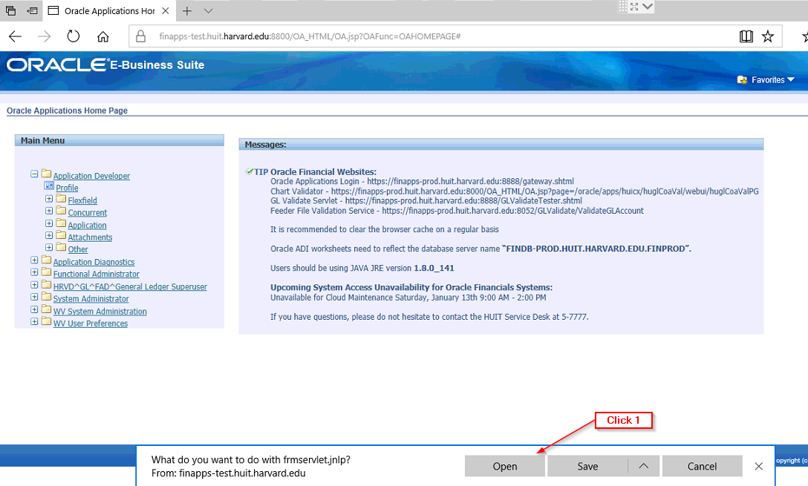
Browser Behavior – Microsoft Edge with Windows
2 Additional Clicks required every time - JNLP Files will be downloaded when you click on any Java Form link in Oracle and then the downloaded JNLP file needs to be clicked once again to launch Java Forms.
No additional Browser setting is required
Recommended to not click Save in the illustration below (Click Open)

Slide 23
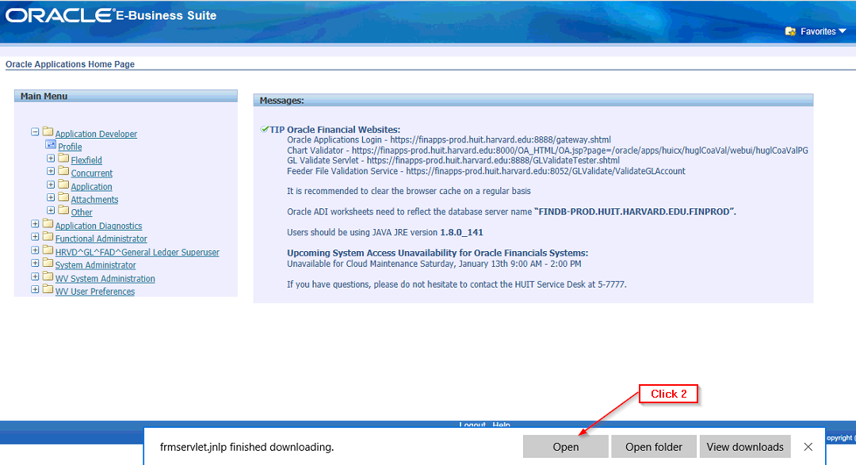
Browser Behavior – Microsoft Edge – contd.

Slide 24
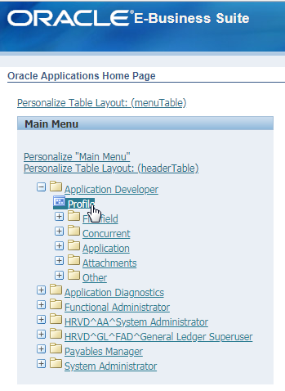
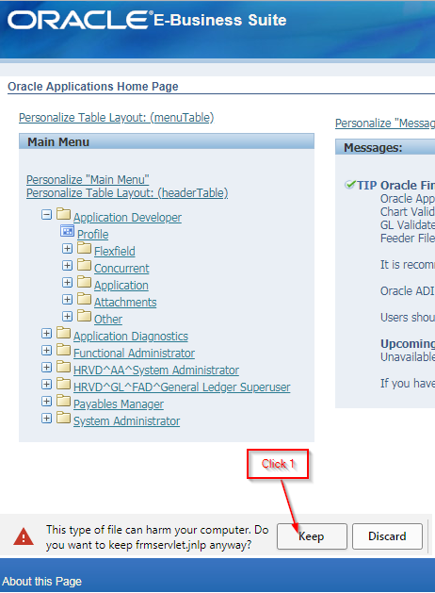
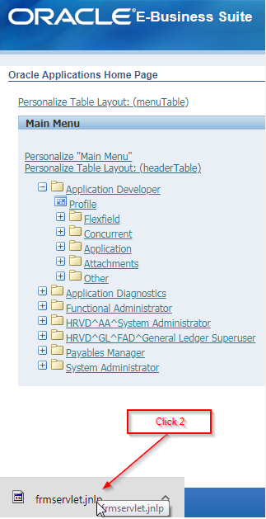
Browser Behavior – Chrome with Windows
2 Additional Clicks required every time - JNLP Files will be downloaded when you click on any Java Form link in Oracle and then the downloaded JNLP file needs to be clicked once again to launch Java Forms.
No additional Browser setting is required

Slide 25
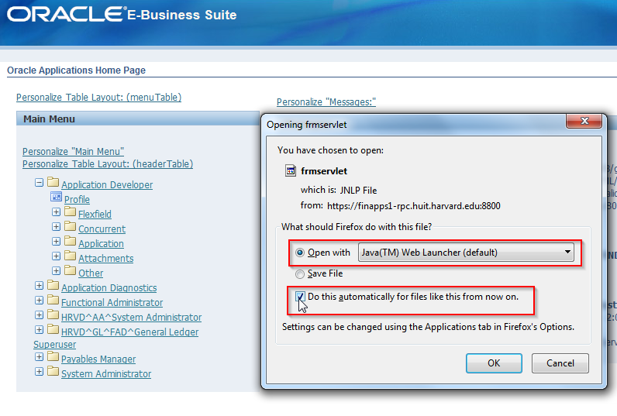
Browser Behavior – Firefox (ESR Release) with Windows
1 Additional Click required only for the first time for the JNLP file. After that Java Forms open without any additional clicks. Please be aware that marking the second box below could introduce a security vulnerability to the desktop. Recommended to not click Save.

Slide 26
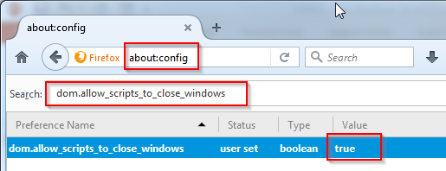
Browser Behavior – Firefox (ESR Release) – contd.
Launching Oracle Forms in Firefox ESR 52 or above leaves an orphan browser tab open.
- This issue is a result of web browser limitations and can be resolved by setting
(dom.allow_scripts_to_close_windows) preference to true.
- This work-around seems to work for most of us but not for all of us. So, you may encounter this even after changing the setting.
- You can safely close the Orphan Tab if you want.
- The HUIT Endpoint team will push this setting to users.

Slide 27
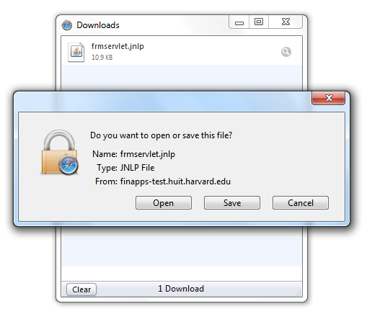
Browser Behavior – Safari with Windows
1 Additional Click required every time – A popup will be displayed when you click on any Java Form link in Oracle asking to Open or Save the JNLP file. Click Open. It is not recommended to click Save.
Safari needs to be set as the Default Browser for it to work properly with Oracle.

Slide 28
Browser Behavior – Safari with Mac
Mac will continue to function as it does today in Production i.e. using the plug-in process
Oracle does not yet support using Java Web Start on a Mac and is continuing to work on a solution.
The main browsers currently used on a Mac are Safari and Firefox. If you have a Mac and need to open forms, the best browser to use will be Safari. FireFox works today but will no longer be an option come end of May, as Firefox will no longer support JRE plug-ins.
Please Note: As stated in our Desktop standards that Oracle Financials is not fully supported on a Mac and should mostly be used for HCOM/iProcurement and other HTML page drive modules.
If a Mac user is encountering issues opening Oracle Forms, they may need their local desktop support to install the latest version of Java JRE. The next supported version to use is JRE 1.8.0_162.

Slide 29
Browser Behavior Summary
Browser | Auto-Open | Auto-Open Details | Known Issues
IE 11 | Yes | Automatic linking to JNLP with JWS through JRE8 update 141 or later | In some cases users may encounter an issue where IE prompts to Login again when navigating from Oracle Forms to HTML pages.
Edge | No | 2 extra clicks required every time | None
Firefox ESR 52 | Yes | 1 extra click required only once when opening forms for the first time | Orphan Browser Tab when launching Oracle Forms
Google Chrome | No | 2 extra clicks required every time | None
Safari for Windows | No | 1 extra click required every time | Safari needs to be set as Default Browser to make Oracle work properly.
Safari for Mac | N.A. | Oracle on Mac uses plugin mode instead of JWS | None
If you have questions, please do not hesitate to contact the HUIT Service Desk at 5-7777.

